Slide 1
Explore Mode 1 Storyboard Version 1.0
The Bard from Racha Den DEMO
26 October 2023

Slide 2
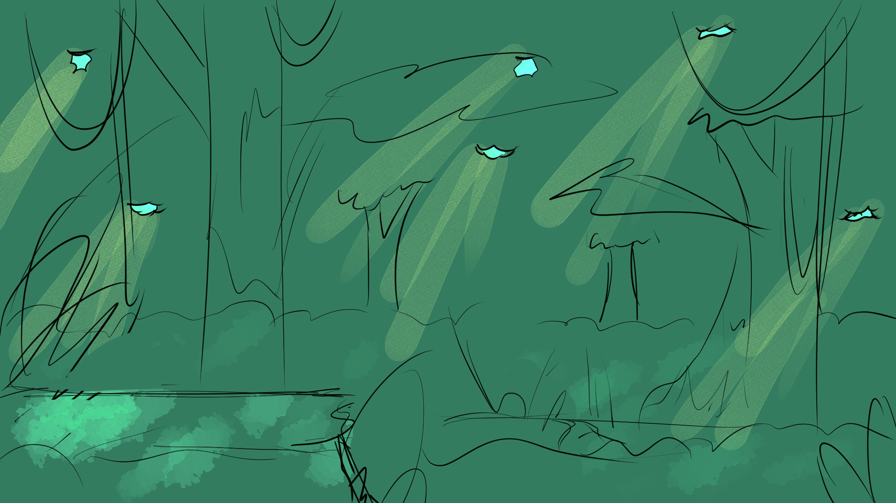
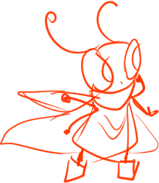

Notes:
START: bg exp1_page 1 WITH DEANNA [animation_deanna right idle cycle].
CLICKABLE: DOWN ARROW [animation_arrow down] / DOWN ARROW LEADS TO [bg exp1_page 2].
DEANNA GOING: RIGHT IDLE [animation_deanna right idle cycle] TO RIGHT WALK [animation_deanna walk right cycle] TO RIGHT JUMP [animation_deanna right jump cycle]

Slide 3
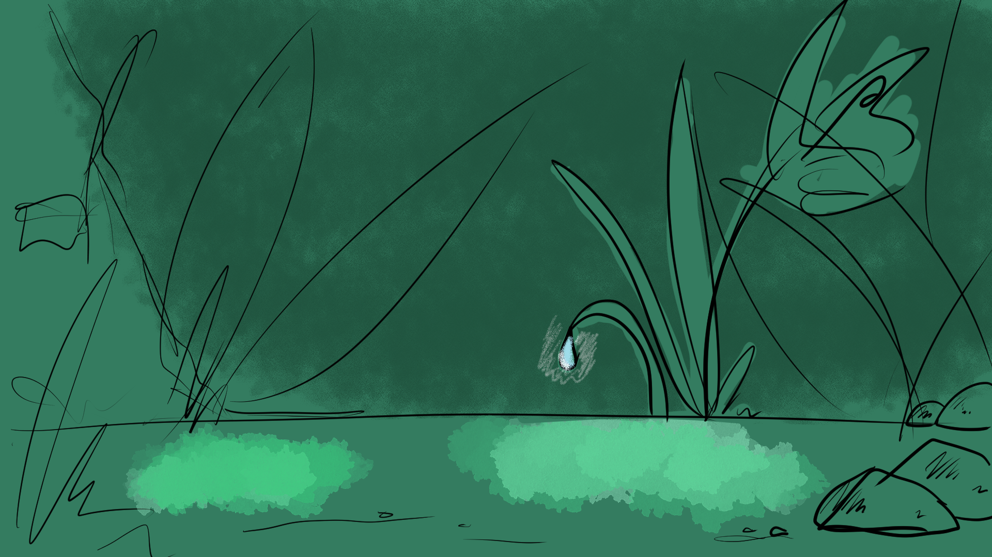


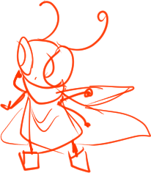
Notes:
START: bg exp1_page 2 / DEANNA LANDS [animation_deanna falling cycle] TO [animation_deanna right idle cycle].
CLICKABLE: PROP [animation_arrow right] LEADS TO [bg exp1_page 4] / PROP [animation-water droplet] LEADS TO [bg exp1_page 3].
DEANNA GOING: RIGHT IDLE [animation_deanna right idle cycle] TO RIGHT WALK [animation_deanna walk right cycle].
DEANNA RETURNING: LEFT IDLE [animation_deanna left idle cycle].

Slide 4
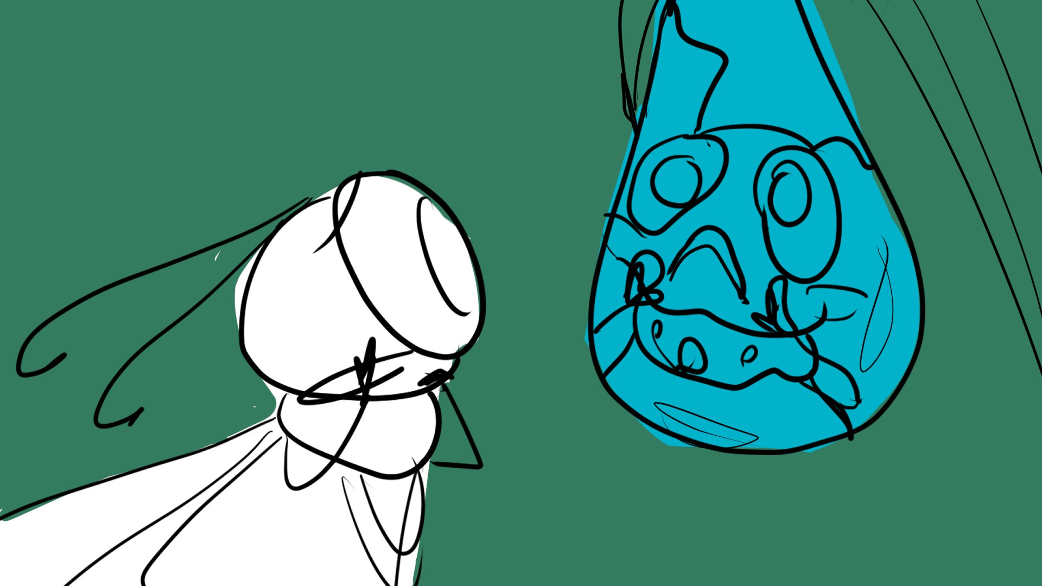
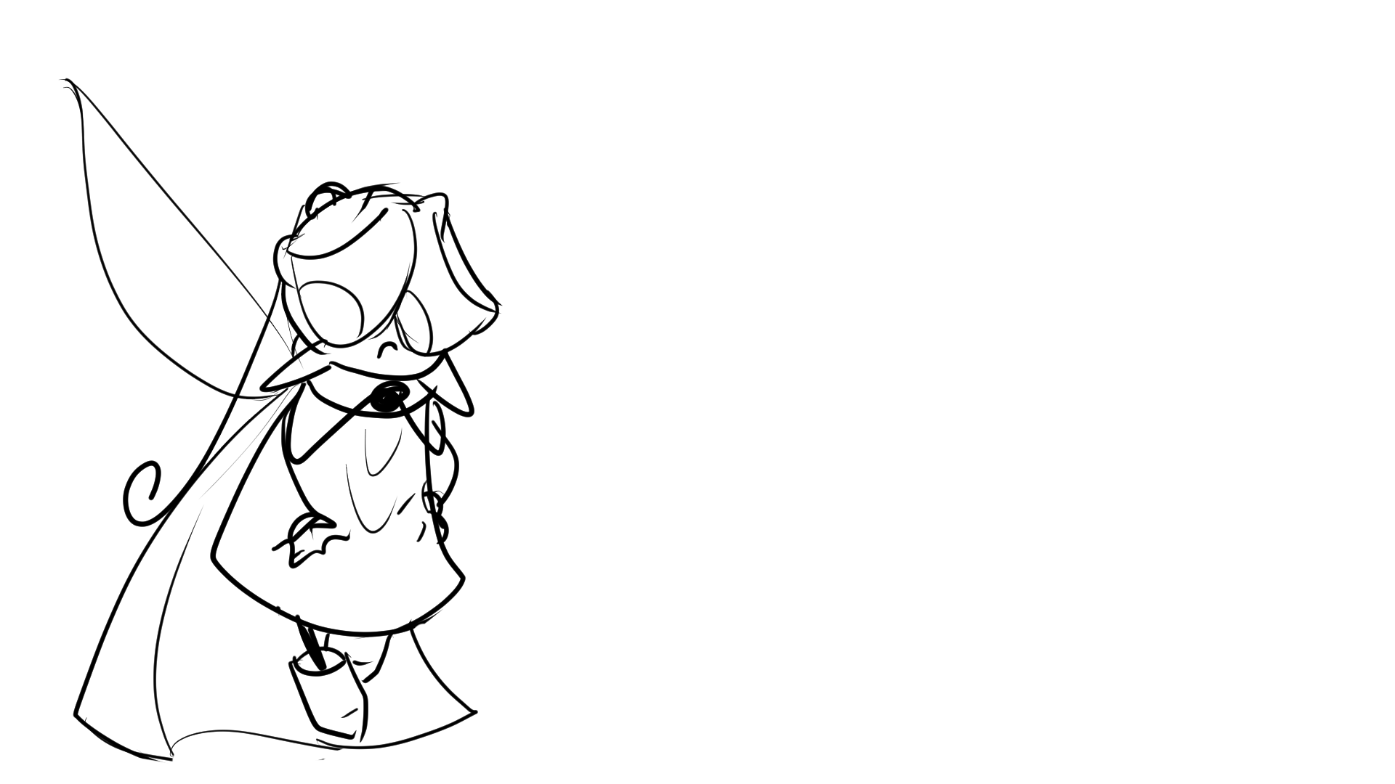
Deanna
“Cockroaches can’t be heroes.”
Deanna peers into her bloated cockroach figure in the dew drop.
Notes:
START: bg exp1_page 3.
SHOW NARRATOR TEXT / SHOW [deanna_close up_regected] WITH TEXT.
CLICKABLE: PROP [animation_arrow down] LEADS TO [bg exp1_page 2].

Slide 5
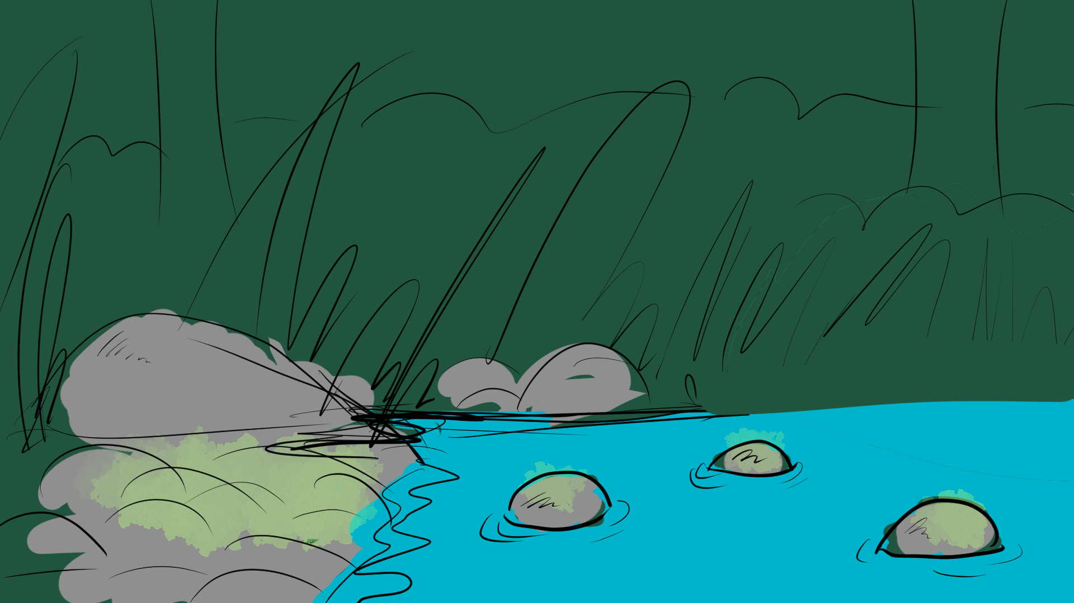

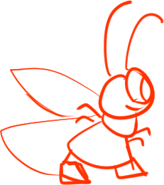

Notes:
START: bg exp1_page 4 / DEANNA RIGHT IDLE [animation_deanna right idle cycle] / ONE ROCK FISH [animation_deanna rock fish cycle 1].
CLICKABLE: PROP [animation_arrow right] LEADS TO [bg exp1_page 4] / PROP [animation_arrow left] LEADS TO [bg exp1_page 2] / FINAL ROCK LEADS TO [bg exp1_page 5].
DEANNA GOING: RIGHT IDLE [animation_deanna right idle cycle] TO RIGHT JUMP [animation_deanna right jump cycle] WITH [animation_deanna rock fish cycle].
DEANNA RETURNING: LEFT IDLE [animation_deanna left idle cycle] TO LEFT JUMP [animation_deanna left jump] WITH [animation_deanna rock fish cycle].
ANIMATIONS: CLICKING BLUE WATER PLAYS [animation_fish left] OR [animation_fish right] / WHEN ROCK FISH CLICKED, PLAY [animation_rock fish] AND SEND DEANNA BACK TO [bg exp1 page 4] BEGINNING.

Slide 6
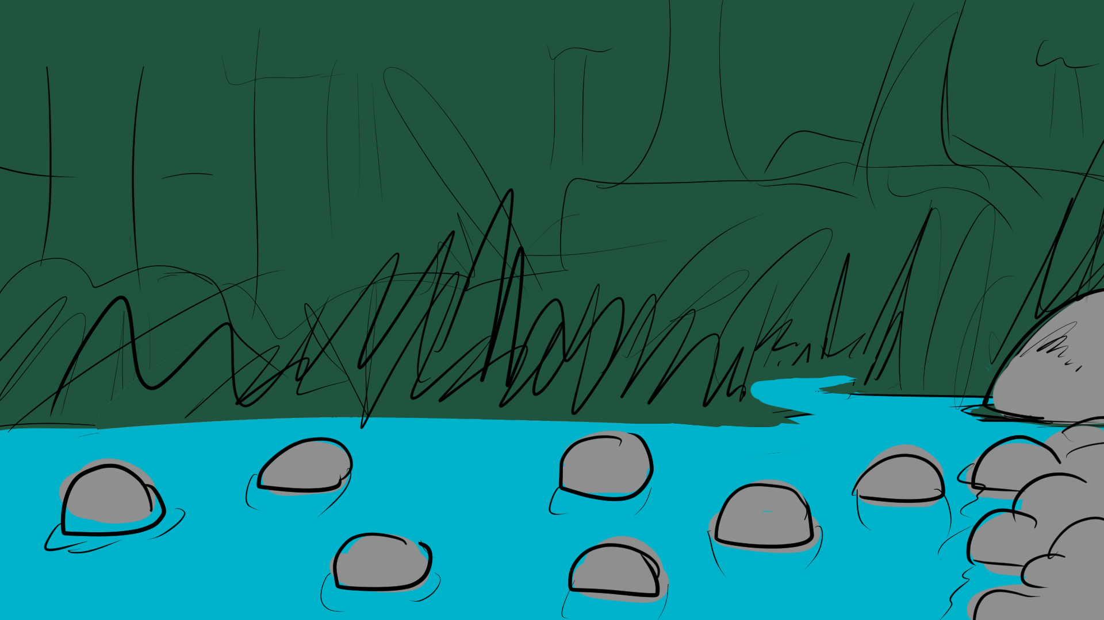
Notes:
START: bg exp1_page 5 / DEANNA RIGHT IDLE [animation_deanna right idle cycle] / TWO ROCK FISH [animation_deanna rock fish cycle 1].
CLICKABLE: FIRST ROCK LEADS TO [bg exp1_page 4] / SHORELINE LEADS TO [bg exp1_page 6].
DEANNA GOING: RIGHT IDLE [animation_deanna right idle cycle] TO RIGHT JUMP [animation_deanna right jump cycle] WITH [animation_deanna rock fish cycle].
DEANNA RETURNING: LEFT IDLE [animation_deanna left idle cycle] TO LEFT JUMP [animation_deanna left jump] WITH [animation_deanna rock fish cycle].
ANIMATIONS: CLICKING BLUE WATER PLAYS [animation_fish left] OR [animation_fish right] / WHEN ROCK FISH CLICKED, PLAY [animation_rock fish] AND SEND DEANNA BACK TO [bg exp1_page 4] BEGINNING.

Slide 7
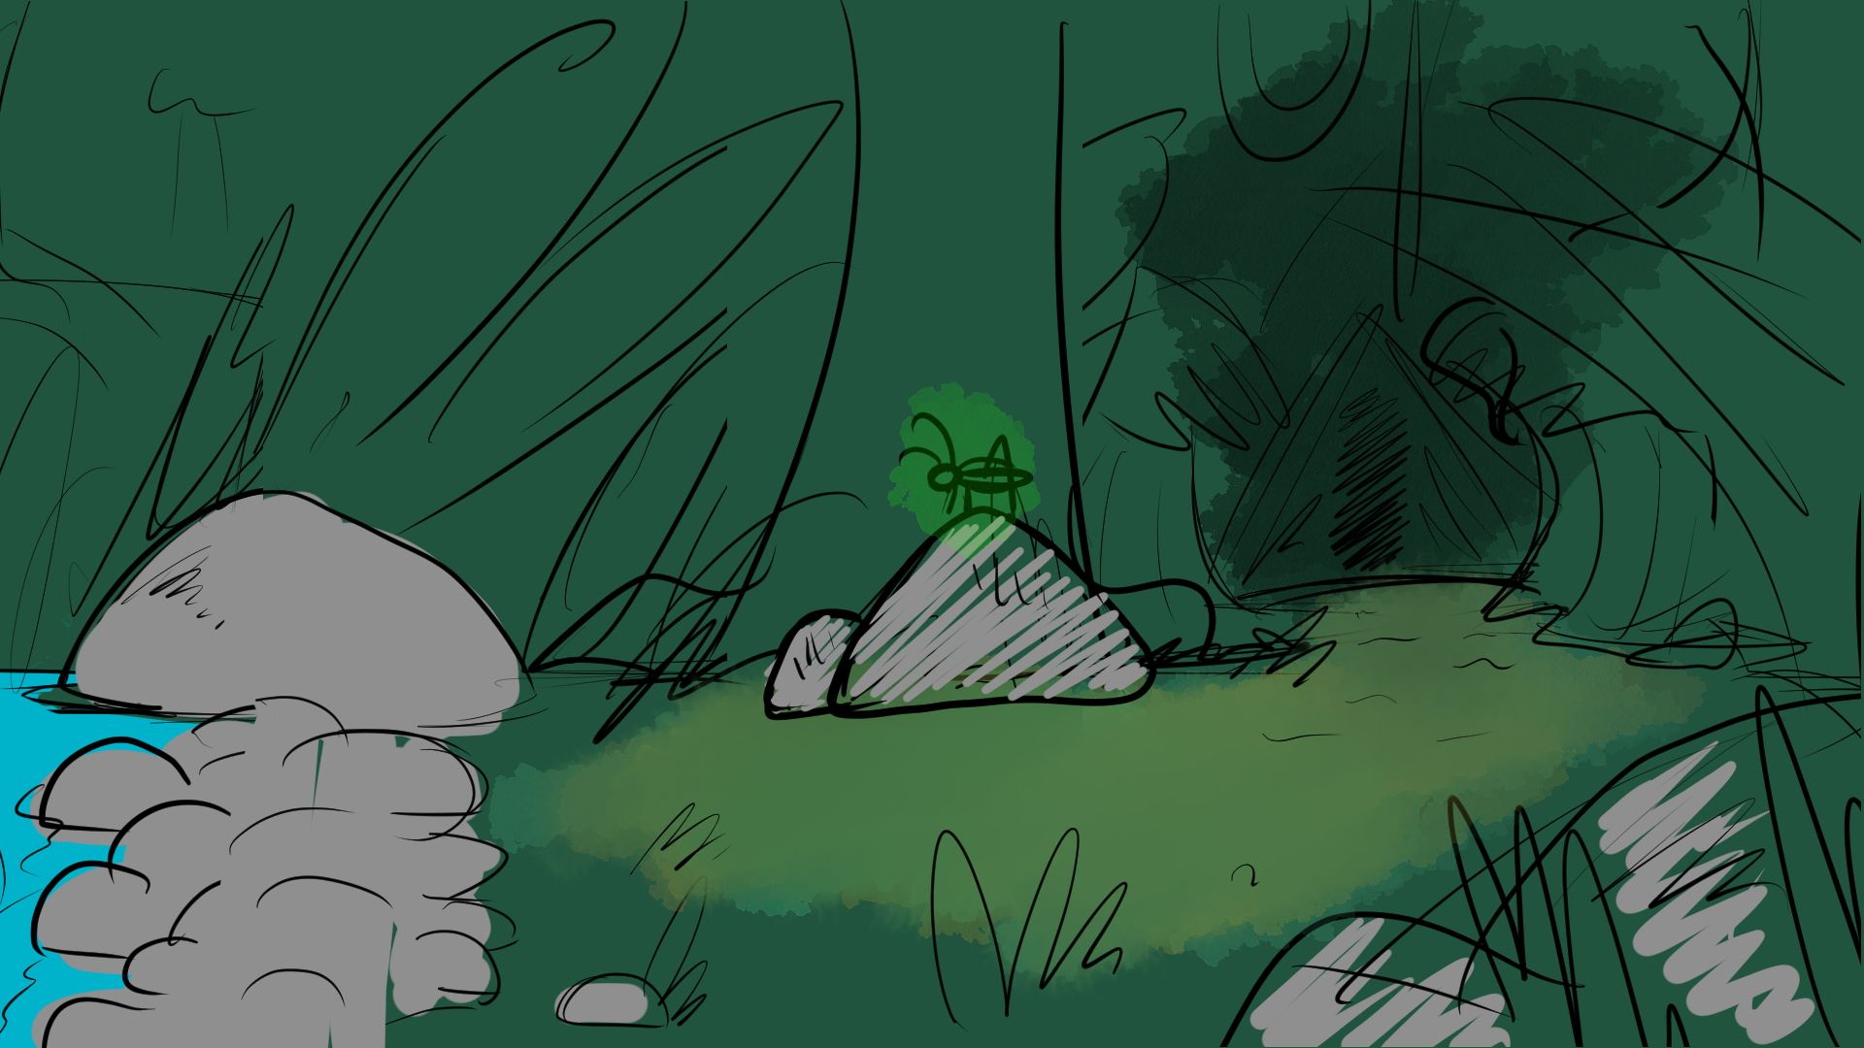

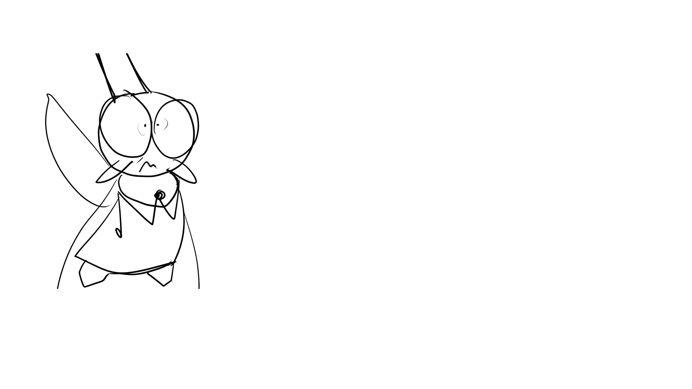


Deanna
“Oh no, that sounded close! I hope my friends are okay!”
Notes:
START: bg exp1_page 6 / DEANNA RIGHT IDLE [animation_deanna right idle cycle] / CRICKET PROP [animation_cricket icon].
SOUND: INSTANTLY PLAY [deep-monster-growl-86780.mp3]
SHOW: [deanna-close up-tense] WITH DEANNA TEXT.
PROP: LEFT AND UP ARROWS [animation_arrow left] & [animation_arrow up].
CLICKABLE: PROP [animation_cricket icon] LEADS TO [bg exp1_page 7] / PROP [animation_arrow left] LEADS TO [bg exp1_page 5] / PROP [animation_arrow up] LEADS TO [bg exp1_page 8].
DEANNA GOING: RIGHT IDLE [animation_deanna right idle cycle] TO RIGHT WALK [animation_deanna right walk cycle].
DEANNA RETURNING: LEFT IDLE [animation_deanna left idle cycle] TO LEFT WALK [animation_deanna left walk cycle].

Slide 8
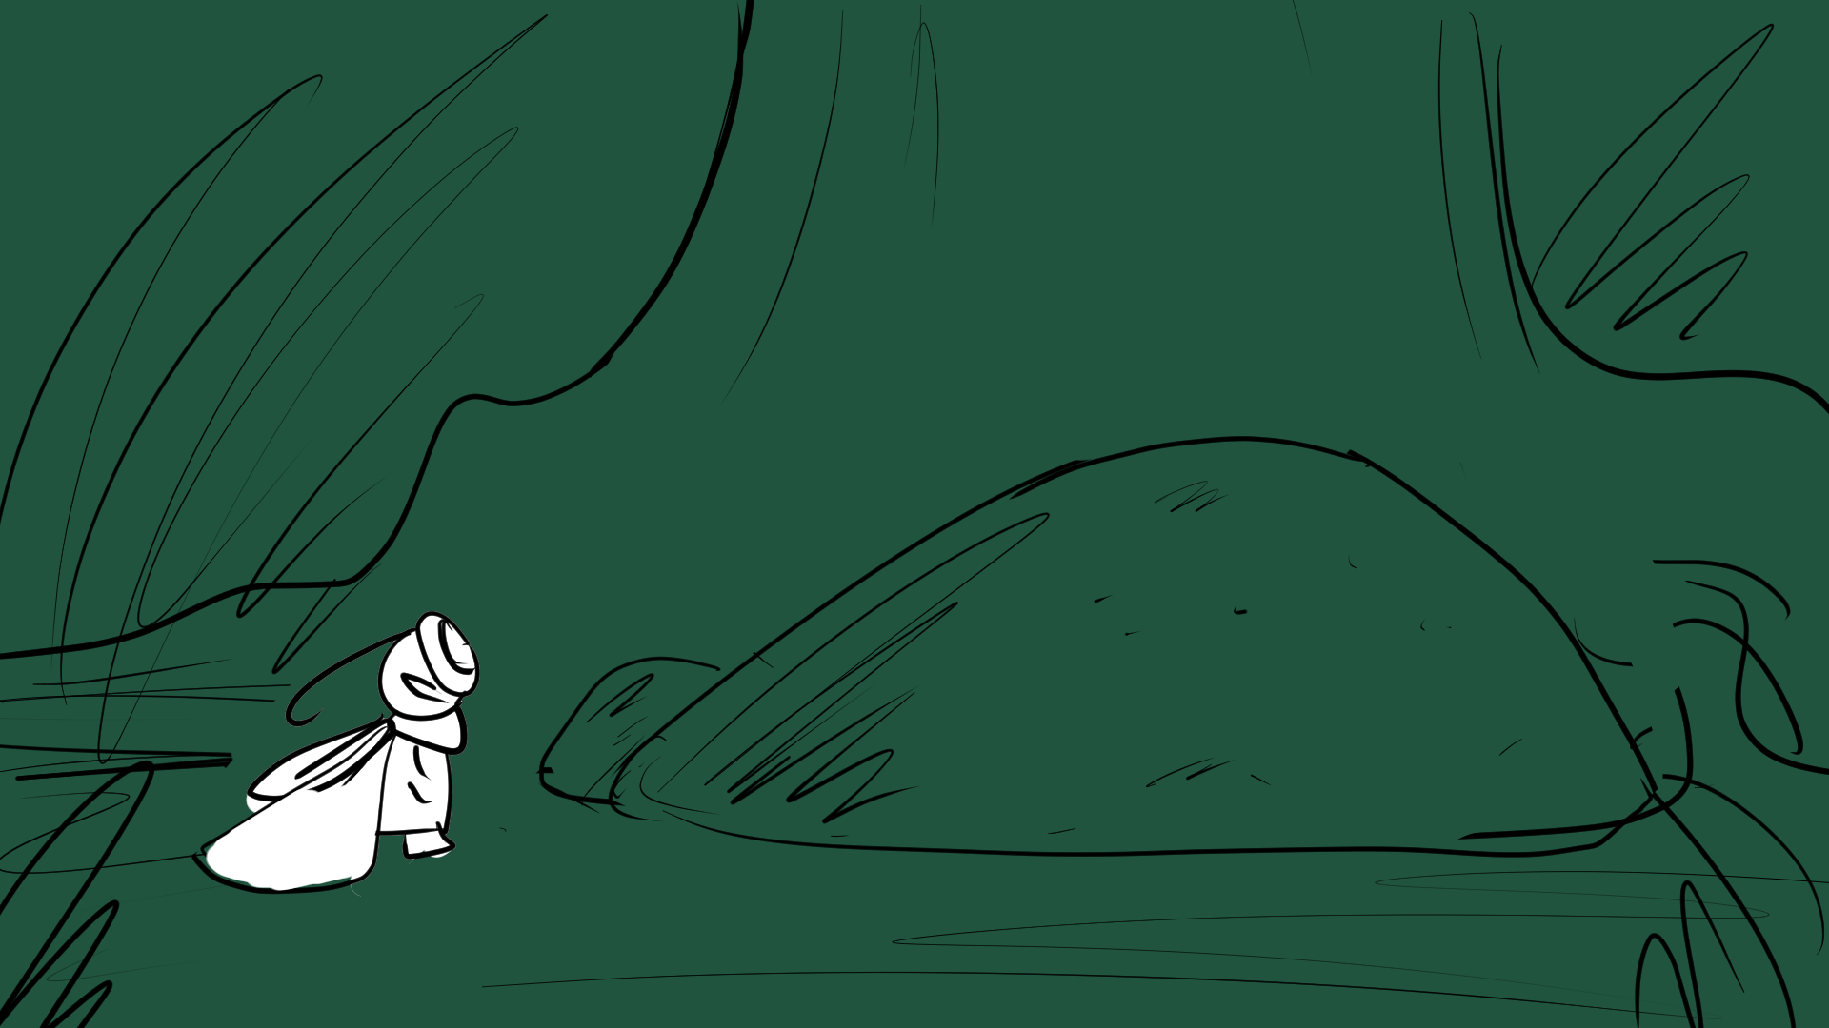

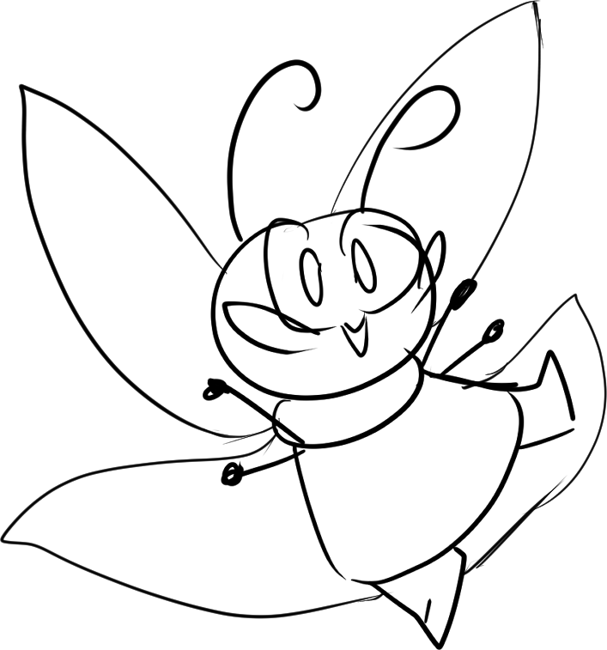

Deanna
Deanna
“Oh, hello! You’re a bug, too! Can you tell me where—”
“That’s right. Bugs can’t normally talk. I wonder if the rest of the world sees me that way.”
Notes:
START: bg exp1_page 7 WITH [animation_cricket 1].
CLICKABLE: [animation_cricket 1] LEADS TO [animation_cricket 2] / PROP [animation_arrow down] LEADS TO [bg exp1_page 6].

Slide 9
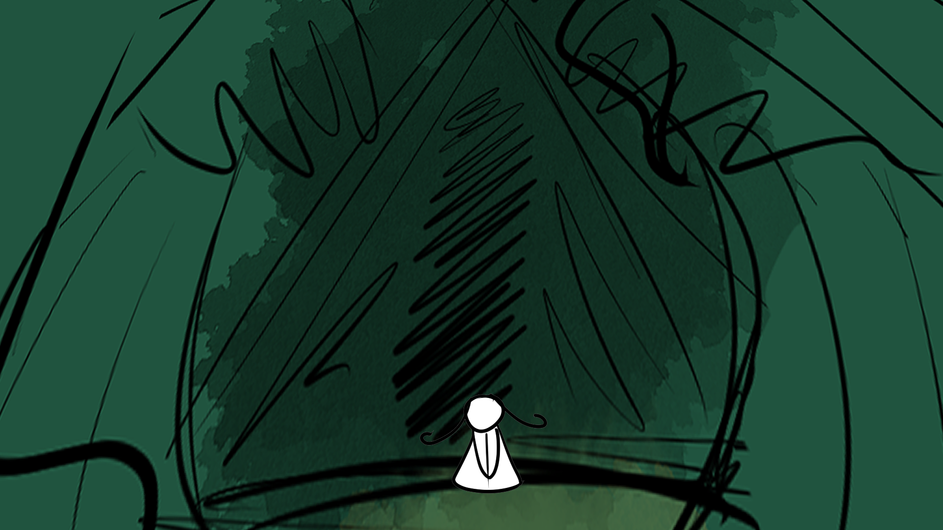
Onwards!
Turn back.
The grumbling was close now. Perhaps just beyond the foliage.
Notes:
START: bg exp1_page 8
SOUND: INSTANTLY PLAY [male-angry-growl-6932.mp3].
SHOW: NARRATOR TEXT.
CLICKABLE: PROP [Onwards! button] LEADS TO [Storybook Mode 2] / PROP [Turn back. button] LEADS TO [bg exp1_page 6].
SHOW: [deanna-close up-tense] WITH DEANNA TEXT.

Slide 10
Deanna
“Here goes nothing...”
Notes:
START: bg exp1_page 8
SOUND: INSTANTLY PLAY [male-angry-growl-6932.mp3].
SHOW: NARRATOR TEXT.
CLICKABLE: PROP [Onwards! button] LEADS TO [Storybook Mode 2] / PROP [Turn back. button] LEADS TO [bg exp1_page 6].
SHOW: [deanna-close up-tense] WITH DEANNA TEXT.

Slide 11
END OF Explore Mode 1
TRANSITION TO Storybook 2

Slide 12
Lethabo
“Dialogue.”
Deanna
“Dialogue.”
Athos
“Dialogue.”
Narration.

